Slide 1
DEPARTMENT OF INFORMATION SCIENCE & ENGINEERING
MAJOR PROJECT REVIEW (22IS76)
Design and Implementation of a Smart Health Monitoring and Early Warning System for Water-Borne Diseases
Presented by:
Under the guidance of:
Aadya Shrivastava :1DS22IS002
Amrutha : 1DS22IS016
Greasha Jain : 1DS22IS053
Vedant Balpande : 1DS22IS181
Dr. Annapurna P Patil
HOD and Dean Academics
Dept. of ISE, DSCE, Bangalore

Slide 2
CONTENTS
Abstract
Introduction
Literature Survey
Problem Statement
Hardware & Software Requirements Specification
System Design & Methodology
Expected Outcomes
References

Slide 3
ABSTRACT
This project aims to develop a web-based Smart Community Health Monitoring and Early Warning System for water-borne diseases in rural areas. It collects health data from local volunteers and health workers, uses AI/ML (Ensemble Model) to predict potential outbreaks, and provides real-time alerts and dashboards for health authorities. The platform also includes educational modules to raise community awareness about hygiene and disease prevention. Designed for accessibility, it supports local languages, enabling timely interventions and improved public health in remote areas. Smart Health Monitoring, Water-Borne Diseases, Early Warning System, Rural Health, Disease Prediction, Community Awareness.

Slide 4
Introduction
The project titled “Design and Implementation of a Smart Community Health Monitoring and Early Warning System for Water-Borne Diseases in Rural Areas” focuses on using AI/ML and data analytics to strengthen public health surveillance in rural regions. Due to limited healthcare access, early detection of water-borne diseases often becomes difficult. This system continuously collects and analyzes environmental and health data to identify potential outbreaks and send timely alerts to health authorities. By enabling early intervention and preventive action, the project aims to reduce disease spread and improve community health outcomes through a smart, technology-driven approach.

Slide 5
LITERATURE SURVEY
Sl. No. | Title | Author | Algorithms / Technique Used | Merits | Demerits / Limitations | Date of Publication
1 | Water Quality Monitoring System for Early Detection of Diseases [1] | A. Kumar, S. Verma | Sensor-based data collection, Threshold analysis | Enables real-time detection of contaminated water; simple and effective for field use | Requires multiple sensors and hardware maintenance | March 2021
2 | Data-Driven Approach for Predicting Outbreaks of Water-Borne Diseases [2] | R. Gupta, M. Patel | Machine Learning (Random Forest, Decision Tree) | Provides accurate outbreak prediction using historical and health data | Needs large and clean datasets; model interpretability issues | July 2022
3 | Community Health Monitoring System Using Cloud and Mobile Applications [3] | P. Sharma, K. Singh | Cloud database, Mobile app integration | Facilitates data sharing and remote health monitoring | Dependent on internet availability and data privacy concerns | November 2020

Slide 6
LITERATURE SURVEY
4 | A Framework for Early Warning of Infectious Diseases Using Environmental and Health Data [4] | L. Chen, J. Park | Rule-based inference, Correlation analysis | Detects relation between environmental changes and disease trends | Slower response time when data updates are infrequent | September 2019
5 | Smart Rural Health Surveillance System Using Data Analytics [5] | N. Das, T. Roy | Data aggregation, Visualization, Statistical analysis | Cost-effective; helps identify rural health trends | Lacks automation and AI-based predictions | February 2023
6 | Disease Outbreak Prediction and Alert System Using Machine Learning [6] | S. Iqbal, H. Ahmed | Naive Bayes, Logistic Regression | Predicts outbreak probabilities based on medical and environmental data | Accuracy affected by imbalanced data | May 2021
7 | Intelligent Public Health Monitoring and Alert System for Rural Communities [7] | V. Mehta, D. Reddy | Rule-based and Trend Detection Algorithms | Improves early warning through pattern recognition and alerts | Limited scalability; manual data collection required | August 2022

Slide 7
PROBLEM STATEMENT
Rural areas often face challenges in detecting and controlling water-borne diseases due to poor water quality monitoring and limited healthcare infrastructure. Existing manual methods are slow and inefficient, leading to delayed responses to outbreaks. There is a need for a web-based intelligent system that uses AI and data analytics to predict, detect, and prevent such outbreaks through real-time health and water-quality data integration.

Slide 8
HARDWARE AND SOFTWARE REQUIREMENTS
Hardware Requirements
Development Machine: Laptop or Desktop PC (Running IDEs, backend servers, and data analysis tasks.)
Processor (CPU): Intel Core i5/Ryzen 5 (or higher) (To handle data processing and run Machine Learning model training/testing efficiently.)
Memory (RAM): 8 GB or 16 GB (Essential for loading and processing large datasets and running multiple software tools concurrently.)
Storage (HDD/SSD): 256 GB SSD (Fast access for reading datasets and writing model outputs.)
Internet Access: Stable Broadband Connection (Crucial for accessing cloud platforms, downloading libraries, and deploying the system.)

Slide 9
HARDWARE AND SOFTWARE REQUIREMENTS
SOFTWARE REQUIREMENTS
Core Development : Python 3.x (Primary language for all analysis and system logic.)
Data Science / ML : Pandas, Scikit-learn (Data handling, cleaning, and building the early warning prediction model.)
Backend / API : Flask (Creating the application logic to run the model and manage alerts.)
Database : SQL (e.g., PostgreSQL/SQLite) (Storing the existing dataset and the resulting risk predictions.)
Frontend : HTML, CSS, JavaScript (Developing the basic web dashboard to visualize outcomes and alerts.)
Cloud Notification Services: AWS SNS - To send real time alerts .

Slide 10
SYSTEM DESIGN AND METHODOLOGY
The proposed system is designed to monitor water quality parameters and provide early warnings about potential water-borne disease outbreaks in rural areas. The system integrates IoT-based sensors, cloud storage, and data analytics to ensure continuous monitoring and timely alert generation.
Data Acquisition: Various sensors such as pH, turbidity, temperature, and TDS sensors are deployed at community water sources. These sensors continuously collect real-time data and send it to a microcontroller (Arduino) for processing.
Data Analysis and Processing: The collected data is analyzed using predefined threshold values and machine learning models to detect anomalies that indicate possible contamination or disease risk. Visualization tools and dashboards help health officials monitor trends over time.

Slide 11
SYSTEM DESIGN AND METHODOLOGY CONTD.
Alert Generation and Reporting: When abnormal readings are detected, the system triggers alerts through SMS, mobile apps, or web dashboards to notify health authorities and community representatives.
Community and Health Integration: The alerts and data insights can be shared with local health departments to initiate sanitation checks, water treatment, or medical interventions, forming an integrated health monitoring ecosystem.

Slide 12
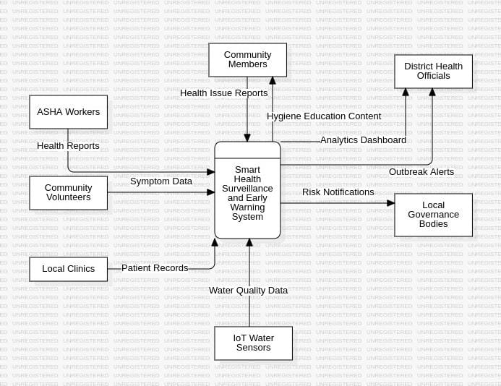
SYSTEM DESIGN AND METHODOLOGY CONTD.
Fig - 1: Data flow diagram level 0 of Smart Health Surveillance and Early Warning System

Slide 13
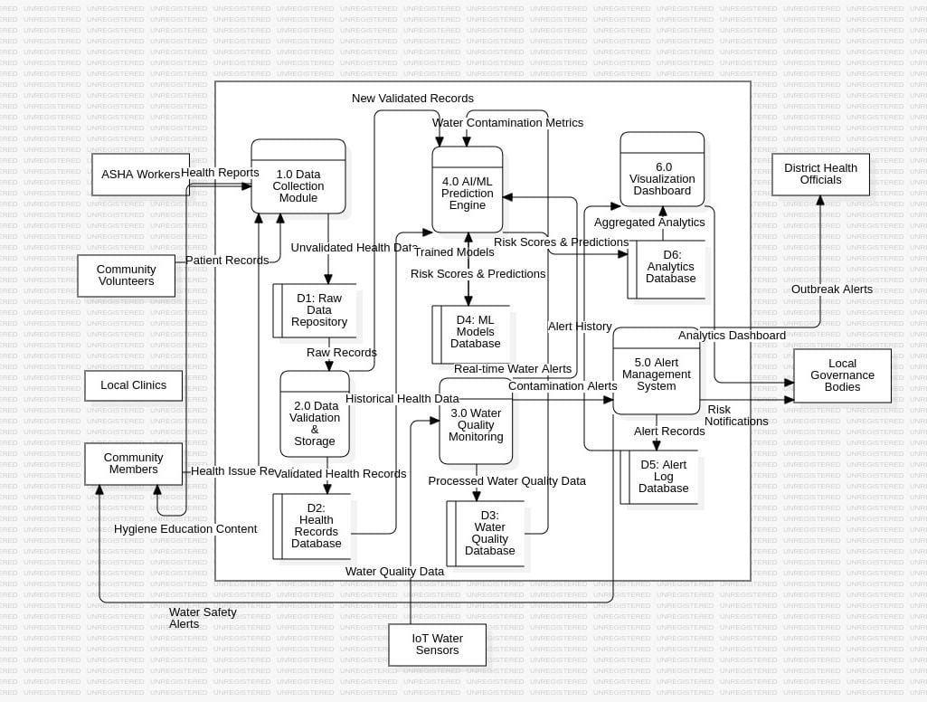
SYSTEM DESIGN AND METHODOLOGY CONTD.
Fig - 2: Data flow diagram level 1 of Smart Health Surveillance and Early Warning System
Department of Information Science & Engineering

Slide 14
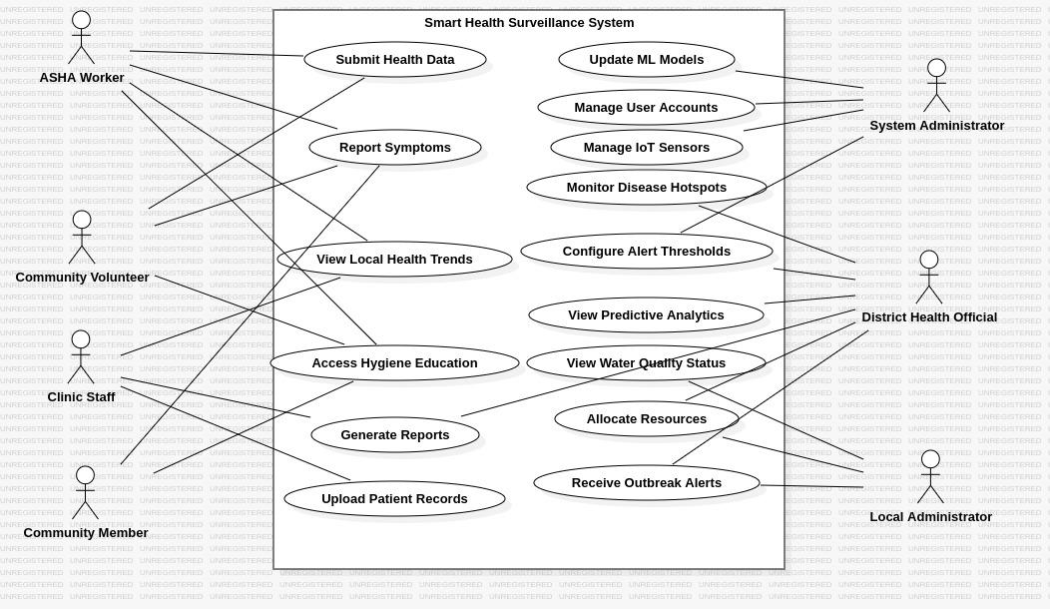
SYSTEM DESIGN AND METHODOLOGY CONTD.
Fig - 3: Use Case diagram of Smart Health Surveillance and Early Warning System

Slide 15
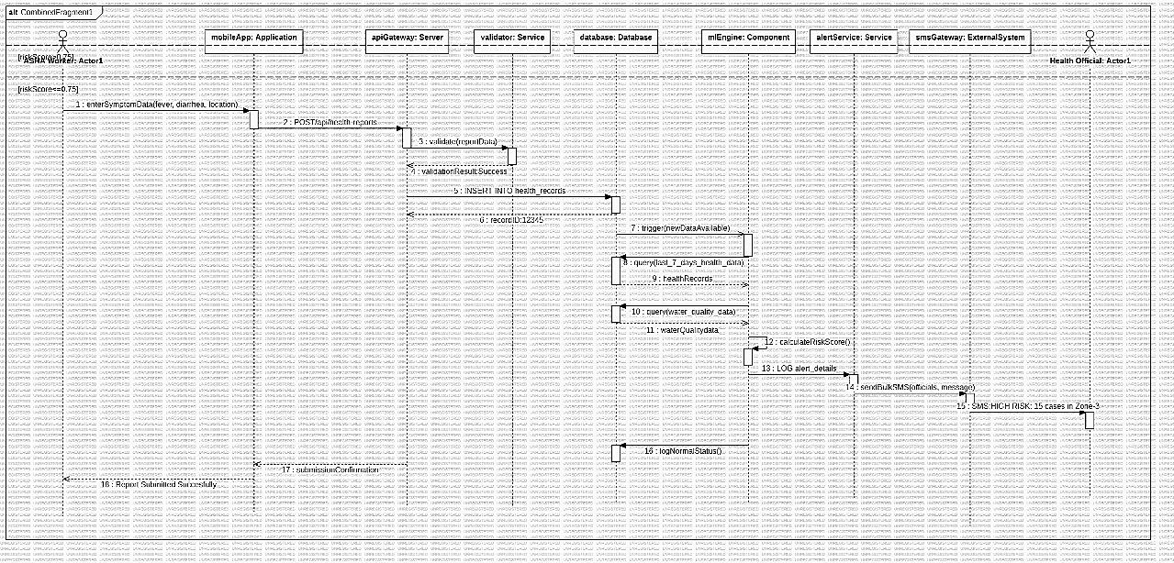
SYSTEM DESIGN AND METHODOLOGY CONTD.
Fig - 4: Sequence diagram of Smart Health Surveillance and Early Warning System

Slide 16
EXPECTED OUTCOMES
The project will successfully deliver a fully functional Smart Early Warning System for rural areas, achieving the following core outcomes:
System Prototype: A deployed, low-cost IoT sensor module connected to a cloud-based dashboard for continuous water quality monitoring.
Rapid Contamination Detection: A working AI/ML algorithm that accurately detects water contamination risks and generates timely alerts to reduce response time from days to hours.
Public Health Improvement: The system enables fast, targeted interventions by health officials, leading to a demonstrable reduction in water-borne disease incidence in the pilot community.

Slide 17
REFERENCES
M. Hussain et al., "Machine learning based efficient prediction of positive cases of waterborne diseases," BMC Med. Inform. Decis. Mak., vol. 23, no. 1, p. 11, Jan. 2023.
M. K. Nallakaruppan et al., "Reliable water quality prediction and parametric analysis using explainable AI models," Sci. Rep., vol. 14, no. 1, p. 7520, Mar. 2024.
T. I. Chinebu et al., "Smart waterborne disease control for a scalable population using biodynamic model in IoT network," Comput. Biol. Med., vol. 181, p. 109034, Oct. 2024.
S. Mangal et al., "Technology Empowerment of ASHA Workers Using E-Health Initiatives in Rural Rajasthan," Healthline, vol. 14, no. 4, pp. 276-281, Dec. 2023.
V. Albert et al., "Surveillance of Food and Waterborne Pathogens in North-East India: Protocol for a Laboratory-Based Sentinel Surveillance Study," JMIR Res. Protoc., vol. 13, no. 2, p. e56469, Oct. 2024.

Slide 18
THANK YOU

